Slide 1
K-12 Computer Science Education:
Unlocking the Future of Students
July 2012
Notes:
Title

Slide 2
Overview
Notes:
Overview

Slide 3
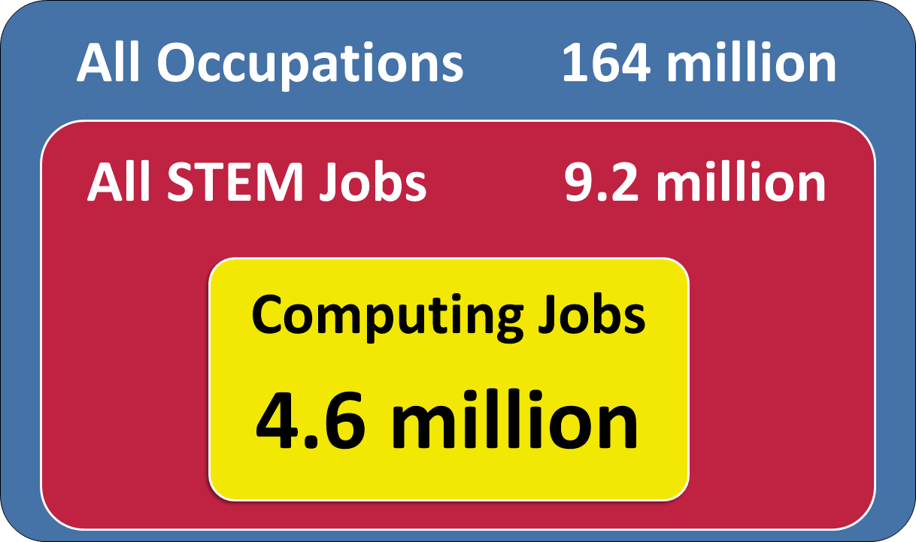
U.S. Workforce through 2020
Sources: Jobs data and mean annual wages are from the Bureau of Labor Statistics (BLS), Employment Projections 2010-2020, available at http://www.bls.gov/emp
Notes:
BLS Data 2010-2020
STEM total includes managers
Computing jobs includes “computer and information systems managers” and computer hardware engineers
9.2 million non-medical STEM workers nationwide in 2020, up from 7.9 million in 2010
4.6+ million computing workers nationwide in 2020, up from 3.9 million in 2010
JOB OPENINGS
3+ million non-medical STEM total job openings through 2020
300,000+ non-medical STEM job openings nationwide annually

Slide 4
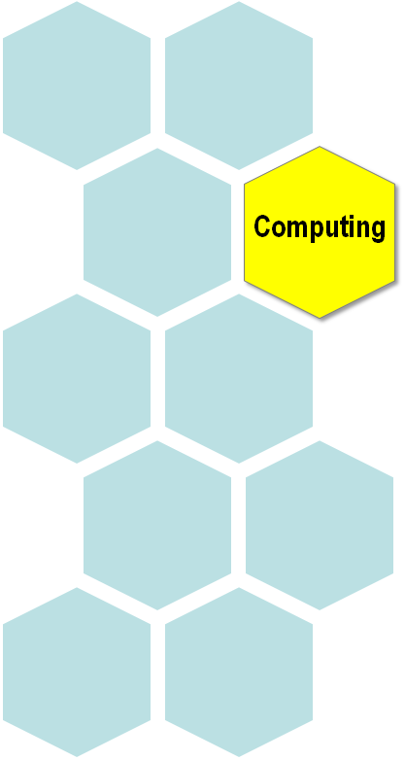
Quick Facts about Computing Jobs Though 2020
Computing and mathematics is one of the
TOP 10 fastest growing major occupational groups 2010-2020.
150,000+ job openings in computing annually.
1 in every 2 STEM jobs will be in computing in 2020.
Sources: Jobs data are calculated from the Bureau of Labor Statistics (BLS), Employment Projections 2010-2020, available at http://www.bls.gov/emp/. Educational levels are calculated from BLS Occupational Projections Data, Employment 2010-2020, available at http://data.bls.gov/oep/ and the BLS Occupational Outlook Handbook 2010-2020, available at http://bls.gov/ooh/.
Notes:
Messaging: Increasing employment growth for computing
1 in every 10 job openings in all occupations 2010-2020
requiring at least a Bachelor’s degree is in computing.
That will become even more favorable in 2020.
85% of computing job openings require
at least a Bachelor’s degree.
91% of computing jobs require some type of post-secondary education.
1 in every 2 non-medical STEM job openings 2010-2020
requiring at least a Bachelor’s degree
will be in computing.

Slide 5
The Bright Future For Computing Jobs

Slide 6
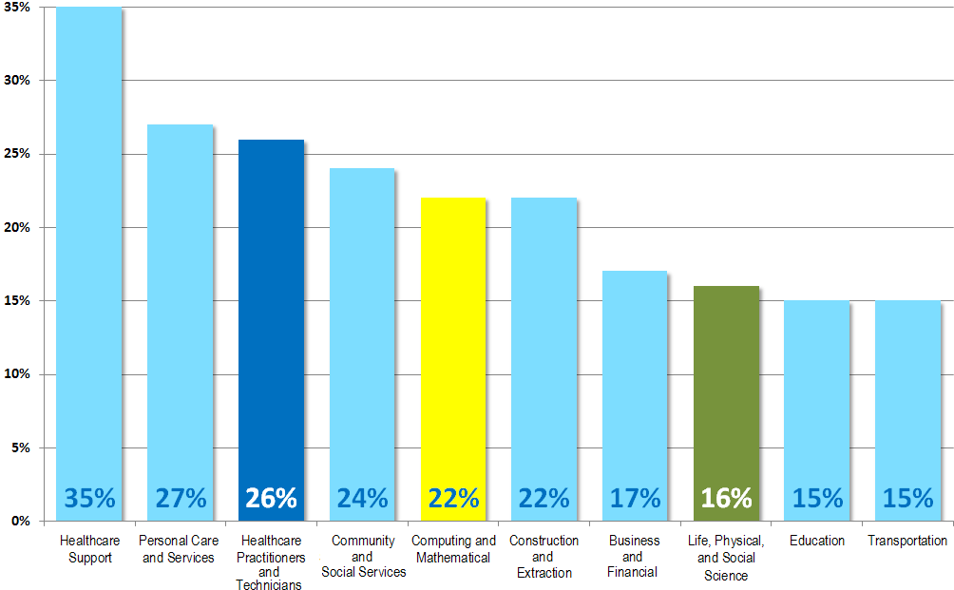
U.S. Employment through 2020
Computing as one of the Fast Growing Sectors
DRAFT
Source: Bureau of Labor Statistics (BLS), Employment Projections 2010-2020, available at http://www.bls.gov/emp/.
Notes:
Messaging: Increasing employment growth for computing

Slide 7
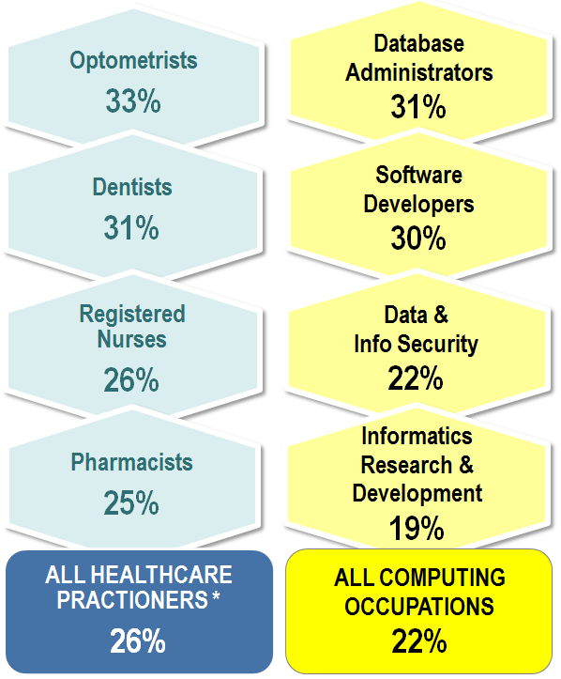
U.S. Employment through 2020
How Computing Stacks Up To Healthcare
22% job growth rate
in computing jobs, as comparable to healthcare job growth rates 2010-2020.
51,000 projected shortfall
in qualified health IT workers 2011-2015.
90% of physicians
to use electronic health records by 2019 as a result of the federal HITECH Act of 2009.
Growth Rates
* Healthcare practitioners and technicians
Sources: Bureau of Labor Statistics (BLS), Employment Projections 2010-2020, available at http://www.bls.gov/emp/. U.S. Department of Health and Human Services (HHS), HITECH Programs, http://www.healthit.gov. Congressional Budget Office, Analysis of HITECH Act of 2009.
Notes:
Messaging: Increasing employment growth for computing
HITECH Act of 2009 = Health Information Technology for Economic and Clinical Health Act
Shortages of healthcare computing professionals. Necessary to enhance productivity, improve quality of care and patient safety, medical records, medical advancements, etc.
Sources: Bureau of Labor Statistics (BLS), Employment Projections 2010-2020, available at http://www.bls.gov/emp/. U.S. Department of Health and Human Services (HHS), Blog on “UBT Program: Preparing the Health IT Leaders of Tomorrow, Today,” (May 12, 2011), available at http://www.healthit.gov/buzz-blog/university-based-training/ubt-program-preparing-health-leaders-tomorrow-today. Congressional Budget Office, Analysis of the Health Information Technology for Economic and Clinical Health (HITECH) Act of 2009, available at http://www.cbo.gov/sites/default/files/cbofiles/ftpdocs/99xx/doc9966/hitechrangelltr.pdf.
----
U.S. Department of Health and Human Services (HHS) “projected shortfall of approximately 51,000 qualified health IT workers over the next four years” i.e. 51,000 trained post-Bachelor’s in degree or certification program. http://www.healthit.gov/buzz-blog/university-based-training/ubt-program-preparing-health-leaders-tomorrow-today HHS Health IT Workforce Development Program funded by the Recovery Act and HITECH Act
“The $2.3 billion US HIS market is expected to grow at a CAGR of nearly 12% and exceed $5.1 billion by 2017. The expected double digit growth in the US HIS market is the result of the healthcare reform initiatives brought in by the Health Information Technology for Economic and Clinical Health (HITECH) Act, a part of the $787 billion American Recovery and Reinvestment Act (ARRA) of 2009. The HITECH Act, signed into law by President Obama in February 2009, allocated up to $27 billion in stimulus funds to accelerate health IT adoption. The reforms brought in by the Act have already provided a significant impetus to the process of healthcare reform through its mandated adoption targets of certified Electronic Health Record (EHR) technology by 90% of physicians and 70% of hospitals by 2019.”

Slide 8
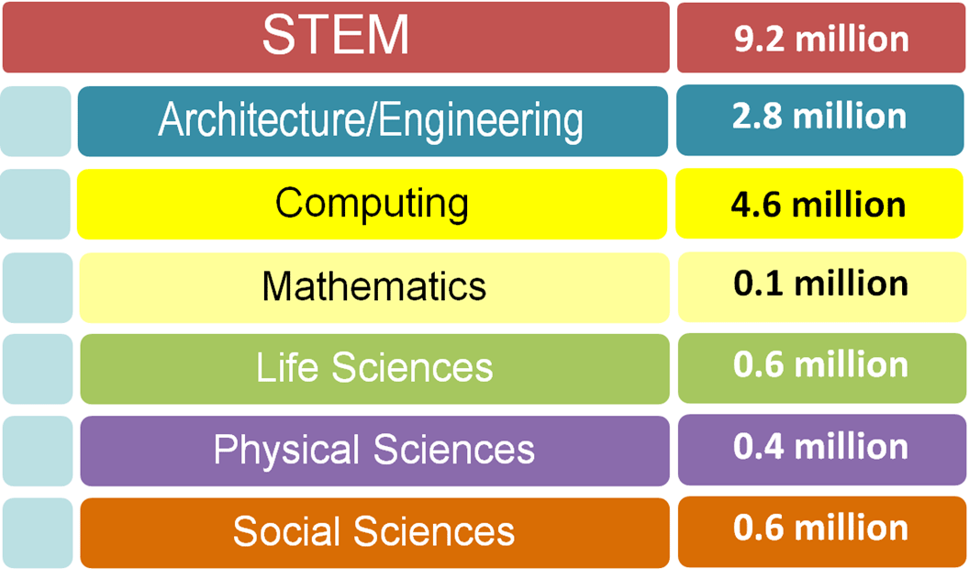
Total Employment in STEM in 2020
Science, Technology, Engineering, and Mathematics
* Subtotals do not equal 9.2 million due to rounding.
Source: Jobs data are calculated from the Bureau of Labor Statistics (BLS), Employment Projections 2010-2020, available at http://www.bls.gov/emp/. STEM is defined here to include non-medical occupations.
Notes:
Messaging: Increasing employment growth for computing
Note on defining STEM
NSF-sponsored STEM scholarships are open to those in the following disciplines:
biological sciences (except medicine and other clinical fields);
physical sciences, including physics, chemistry, astronomy, and materials science;
mathematical sciences;
computer and information sciences;
geosciences;
engineering;
technology areas associated with the preceding fields (for example, biotechnology, chemical technology, engineering technology, information technology, etc.)
NSF considers medical / healthcare as “STEM-related” (funding activities by NIH)
BLS did not include healthcare or medical jobs in its 2011 report on STEM occupations. BLS considers 97 occupations to be within the definition of “STEM” but excluded managers.
U.S. Department of Education in its 2009 report defines STEM as STEM fields, as defined here, include mathematics; natural sciences (including physical Sciences and biological/agricultural sciences); engineering/engineering technologies; and computer/information sciences. http://nces.ed.gov/pubs2009/2009161.pdf

Slide 9
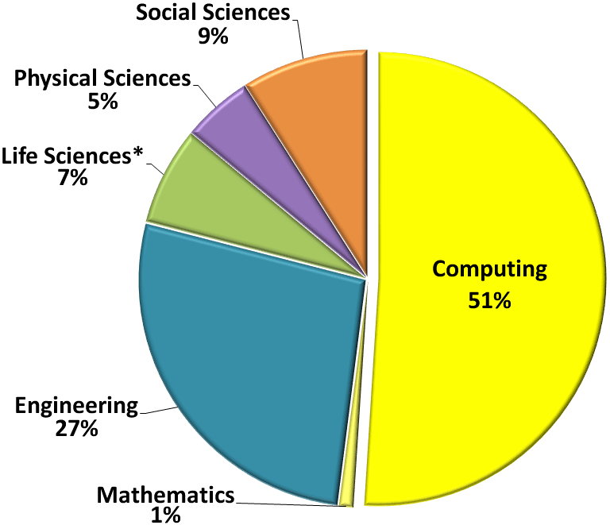
Where the STEM Jobs Will Be
Projected Annual Growth of Total STEM Job Openings 2010-2020
* STEM is defined here to include non-medical occupations.
Source: Jobs data are calculated from the Bureau of Labor Statistics (BLS), Employment Projections 2010-2020, available at http://www.bls.gov/emp/.
Notes:
Messaging: Increasing employment growth for computing
BLS defines STEM as 97 occupations in Computer, Math, Architecture, Engineering, Life Sciences, Physical Sciences, and Social Sciences. The above graph also includes 4 additional managerial categories: (1) computing and IS managers, (2) engineering managers, (3) national sciences managers, and (4) “social and community service” managers. Thus, there are 101 total occupations used to calculate annual STEM jobs above.
Using the BLS Employment Projections 2010-2010, the 101 STEM occupations are 5.5% of all jobs nationwide. CS jobs currently are 2.7% of all jobs nationwide.
During 2010-2020, computing jobs will constitute more than 1 in every 2 STEM jobs. [Does that number increase for jobs requiring a bachelor’s degree?]
Social sciences, according to BLS, includes anthropologists, archeologists, economists, geographers, political science, psychologists, urban planners, and other social scientists.
Physical sciences, according to BLS, includes astronomers, atmospheric, chemists, geological, hydrologists, materials, and other physical sciences.
Life sciences, according to BLS, includes agricultural, animal, biochemists, biophysicists food, conservation, foresters, microbiology, plant, and soil. BLS INCLUDES epidemiologists and medical scientists, will include also in MEDICAL, in later slides.
Engineering, according to BLS, architects, aerospace, chemical, civil, electrical, environmental, industrial, marine, materials, mechanical, mining, nuclear, drafters, and technicians. BLS INCLUDES IN ENGINEERING BUT INCLUDED IN CS & MATH in ABOVE GRAPH – [computer hardware engineers, 2290 annual job openings (<1% of STEM jobs)]
Computing and Mathematics, according to BLS, includes developers & programmers, database administrators, network, information security, network, and support specialists. Math includes actuaries, mathematicians, research, statisticians, and technicians.
Using May 2011 data from the Occupational Employment Statistics (OES) program, STEM jobs are 6% of all jobs nationwide. CS jobs are 2.7% of all jobs nationwide.
Note: NSF considers medical as STEM-related. Treated separately on other slides.

Slide 10
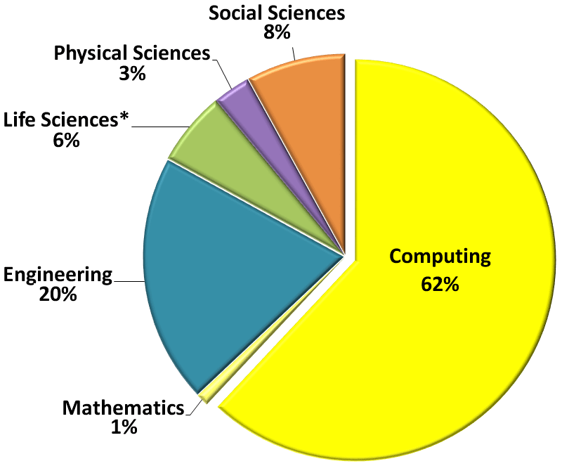
Where the STEM Jobs Will Be
Projected Annual Growth of NEWLY CREATED STEM Job Openings 2010-2020
* STEM is defined here to include non-medical occupations.
Source: Jobs data are calculated from the Bureau of Labor Statistics (BLS), Employment Projections 2010-2020, available at http://www.bls.gov/emp/.
Notes:
Messaging: Increasing employment growth for computing
BLS defines STEM as 97 occupations in Computer, Math, Architecture, Engineering, Life Sciences, Physical Sciences, and Social Sciences. The above graph also includes 4 additional managerial categories: (1) CS managers, (2) engineering managers, (3) national sciences managers, and (4) “social and community service” managers. Thus, there are 101 total occupations used to calculate annual STEM jobs above.
Using the BLS Employment Projections 2010-2010, the 101 STEM occupations are 5.5% of all jobs nationwide. CS jobs currently are 2.7% of all jobs nationwide.
During 2010-2020, computing jobs will constitute more than 1 in every 2 STEM jobs. [Does that number increase for jobs requiring a bachelor’s degree?]
Social sciences, according to BLS, includes anthropologists, archeologists, economists, geographers, political science, psychologists, urban planners, and other social scientists.
Physical sciences, according to BLS, includes astronomers, atmospheric, chemists, geological, hydrologists, materials, and other physical sciences.
Life sciences, according to BLS, includes agricultural, animal, biochemists, biophysicists food, conservation, foresters, microbiology, plant, and soil. BLS INCLUDES epidemiologists and medical scientists, will include also in MEDICAL, in later slides.
Engineering, according to BLS, architects, aerospace, chemical, civil, electrical, environmental, industrial, marine, materials, mechanical, mining, nuclear, drafters, and technicians. BLS INCLUDES IN ENGINEERING BUT INCLUDED IN CS & MATH in ABOVE GRAPH – [computer hardware engineers, 2290 annual job openings (<1% of STEM jobs)]
Computing and Mathematics, according to BLS, includes developers & programmers, database administrators, network, information security, network, and support specialists. Math includes actuaries, mathematicians, research, statisticians, and technicians.
Using May 2011 data from the Occupational Employment Statistics (OES) program, STEM jobs are 6% of all jobs nationwide. CS jobs are 2.7% of all jobs nationwide.
Note: NSF considers medical as STEM-related. Treated separately on other slides.

Slide 11
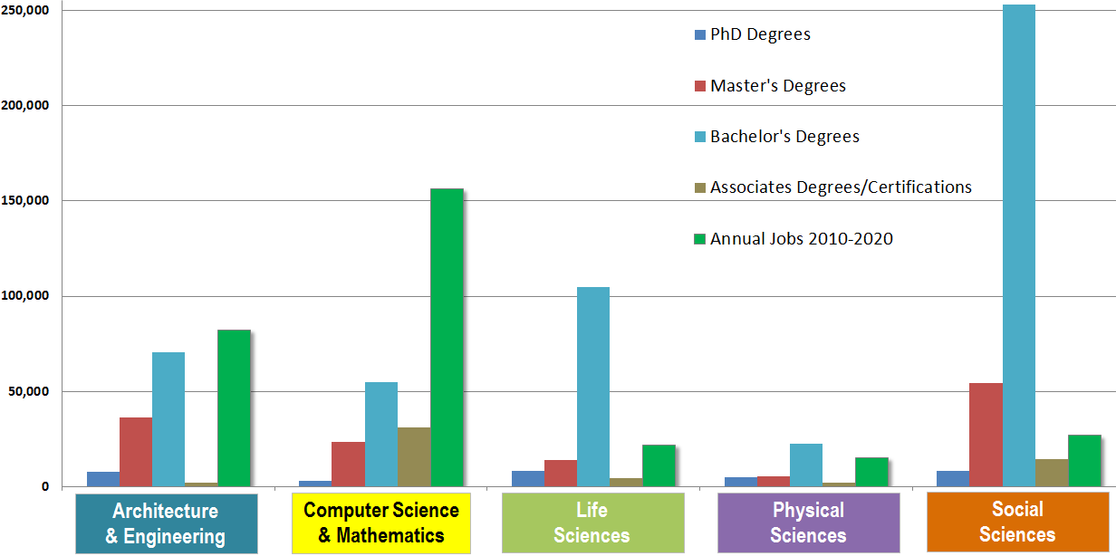
Where the STEM Jobs Will Be
Degrees vs. Jobs Annually
Sources: Degree data are calculated from the National Science Foundation (NSF), Science and Engineering Indicators 2012, available at http://www.nsf.gov/statistics/seind12/appendix.htm. Annual jobs data are calculated from the Bureau of Labor Statistics (BLS), Employment Projections 2010-2020, available at http://www.bls.gov/emp/. STEM is defined here to include non-medical degrees and occupations.
Notes:
Messaging: Increasing employment growth for computing
Computing and Mathematics is the ONLY STEM category
in which job demand exceeds and will continue to exceed trained/skilled supply.
Consistent with NSF and BLS definitions, STEM includes non-medical degrees and occupations.

Slide 12
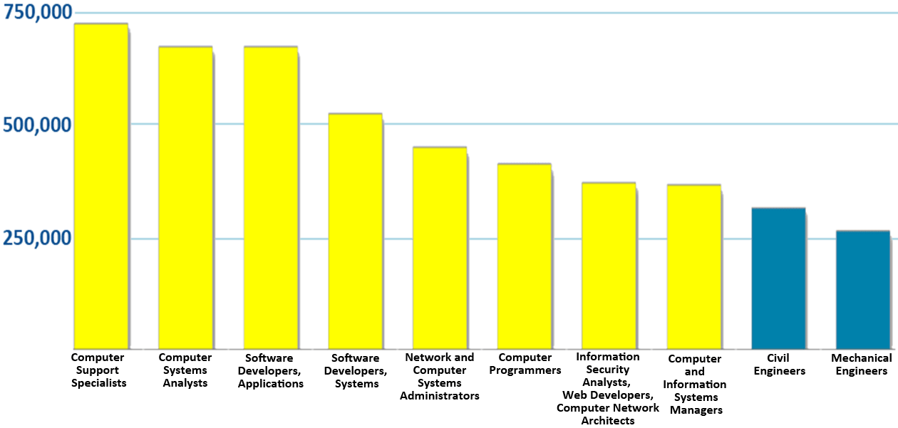
Where the STEM Jobs Will Be
Top 10 STEM Occupations by Total Employment in 2020
Source: Jobs data are calculated from the Bureau of Labor Statistics (BLS), Employment Projections 2010-2020, available at http://www.bls.gov/emp/. STEM is defined here to include non-medical occupations.
Notes:
Messaging: Increasing employment growth for computing
Largest STEM Occupations in 2020
All categories --- except computer support specialists --- require a Bachelor’s degree.
Computer support specialists will be 20% of computing and mathematics occupations in 2020.

Slide 13
Earnings Potential in Computing
Notes:
Earnings

Slide 14
Where the U.S. Jobs Will Be
Top 10 Major Occupational Groups 2010-2020 and Average Salaries in May 2011
 | Major Occupational Group | % Growth 2010-2020 | 2011 Average Annual Salary
1 | Healthcare Support Occupations | 35% | $27,370
2 | Personal Care and Service Occupations | 27% | $24,620
3 | Healthcare Practitioners and Technical Occupations | 26% | $72,730
4 | Community and Social Service Occupations | 24% | $43,830
5 | Construction and Extraction Occupations | 22% | $44,630
6 | Computing and Mathematical Occupations | 22% | $78,730
7 | Business and Financial Operations Occupations | 17% | $68,740
8 | Life, Physical, and Social Science Occupations | 16% | $67,470
9 | Education, Training, and Library Occupations | 15% | $50,870
10 | Transportation and Material Moving Occupations | 15% | $33,200
Sources: Jobs data are from the Bureau of Labor Statistics (BLS), Employment Projections 2010-2020, available at http://www.bls.gov/emp/. Salary data are from BLS Occupational Employment Statistics, May 2011, available at http://www.bls.gov/oes/current/oes_nat.htm.
Notes:
Messaging: Increasing employment and higher earnings
National average employment growth 2010-2020 = 14.3 %
National median annual salary = $45,230
Average computing salaries with managers = roughly $86,400

Slide 15
Where the STEM Jobs Will Be
Projected Growth of Selected STEM Jobs 2010-2020
STEM Job | 2010 Total Employment | % Growth 2010-2020 | 2011 Average Annual Salary
Engineering and Architectural Managers | 176,800 | 9% | $129,350
Computer and Information Systems Managers | 307,900 | 18% | $125,660
Aerospace Engineers | 81,000 | 5% | $103,870
Software Developers, Systems and Applications | 913,100 | 30% | $96,250
Biochemists and Biophysicists | 25,100 | 31% | $87,640
Civil Engineers | 262,800 | 19% | $82,710
Database Administrators | 110,800 | 31% | $77,350
Environmental Scientists | 89,400 | 19% | $68,810
Chemists | 82,200 | 4% | $74,780
Anthropologists and Archeologists | 6,100 | 21% | $59,040
Sources: Jobs data are from the Bureau of Labor Statistics (BLS), Employment Projections 2010-2020, available at http://www.bls.gov/emp/. Salary data are from BLS Occupational Employment Statistics, May 2011, available at http://www.bls.gov/oes/current/oes_nat.htm.
STEM is defined here to include non-medical occupations.
Notes:
Messaging: Increasing employment and higher earnings
Purpose is to highlight NUMERIC (Total Employment) versus PERCENTAGE (Growth) change.
Highest Paid
Not in table above because they have less total employment than Aerospace Engineers and visual space is limited.
Nuclear Engineers (18,430 employment; $105,160)
Petroleum Engineers (30,880 employment; $138,980)

Slide 16
Pipeline of Talent in Computing
Notes:
Pipeline

Slide 17
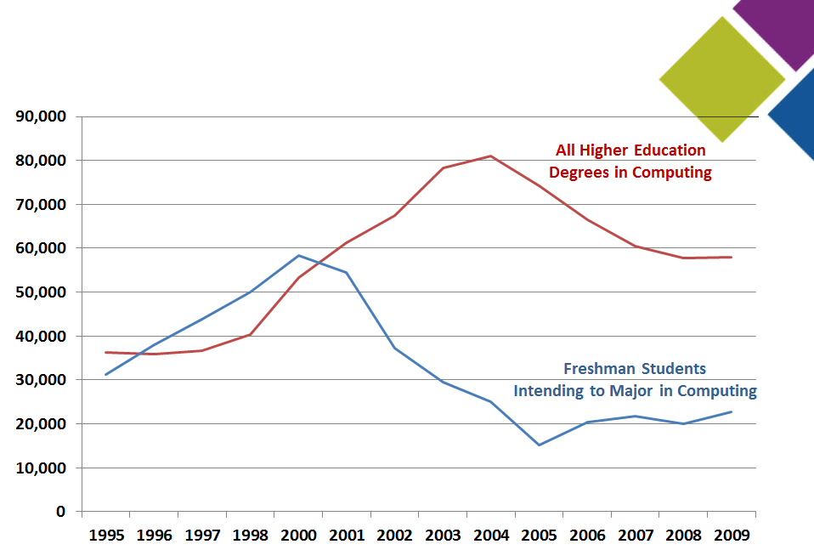
Higher Education Pipeline in Computing
Source: National Science Foundation, Science and Engineering Indicators 2012 and various years, available at http://www.nsf.gov/statistics/seind12/. Data are not available from 1999.
Notes:
Messaging: Need for increased education
1995-2009
Data are not available for 1999.
Data tables for S&E Indicators 2012, http://www.nsf.gov/statistics/seind12/appendix.htm
Freshman intending to Major 1995-2010, http://www.nsf.gov/statistics/seind12/append/c2/at02-12.pdf
Additional Resources:
http://www.nsf.gov/statistics/degrees/
https://webcaspar.nsf.gov/TableBuilder?expired_dt=1#m

Slide 18
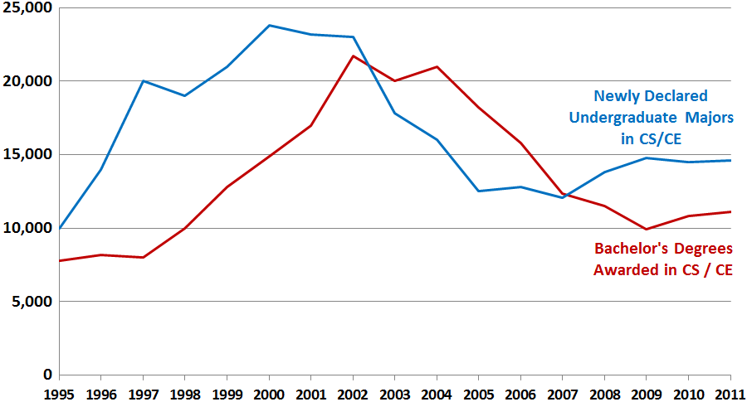
Higher Education Pipeline in Computing
CRA Taulbee Survey Results
Source: Computing Research Association, Taulbee Survey 2010-2011, available at http://www.cra.org/resources/taulbee/ (providing voluntary responses from Ph.D.-granting universities on new enrollments and degrees awarded in their undergraduate CS/CE programs.
Notes:
Messaging: Need for increased education
Date are approximate 1995-2011.
The above approximates Figures B1 and B2 in the 2010-2011 survey.
http://www.cra.org/uploads/documents/resources/crndocs/Taulbee_2010-11-sm
http://www.cra.org/resources/taulbee/ (recent archived Taulbee reports)
http://archive.cra.org/statistics/ (all available archived Taulbee reports). Note: several years do not provide information on new enrollment of Master’s and Bachelor’s students.
Additional Resources:
http://www.nsf.gov/statistics/degrees/
https://webcaspar.nsf.gov/TableBuilder?expired_dt=1#m

Slide 19
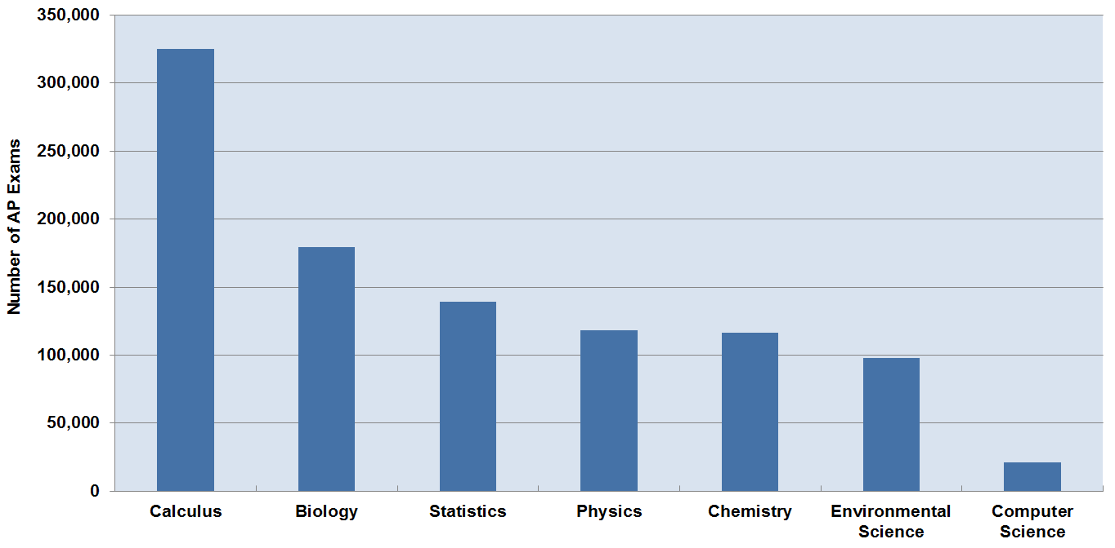
High School Advanced Placement
Exams 2011
Computer Science
Source: College Board, Advanced Placement (AP) Exam Data 2011, available at http://professionals.collegeboard.com/data-reports-research/ap/data. Calculus represents the combined data of Calculus AB and BC. Physics represents the combined data of Physics B, C:Electricity and Magnetism, and C:Mechanics. Computer Science represents combined data of Computer Science A and B.
Notes:
Messaging: Need for increased education
Total Exams 3.4 million 3,365,617
Total science on graph: 1 million 997,334 (23%):
Computer Science 21,139 (2% of the sciences shown, 1% of all AP exams)
Calculus 324,933
Biology 179,544
Statistics 138,991
Physics 118,320
Chemistry 116,608
Environmental Science 97,799

Slide 20
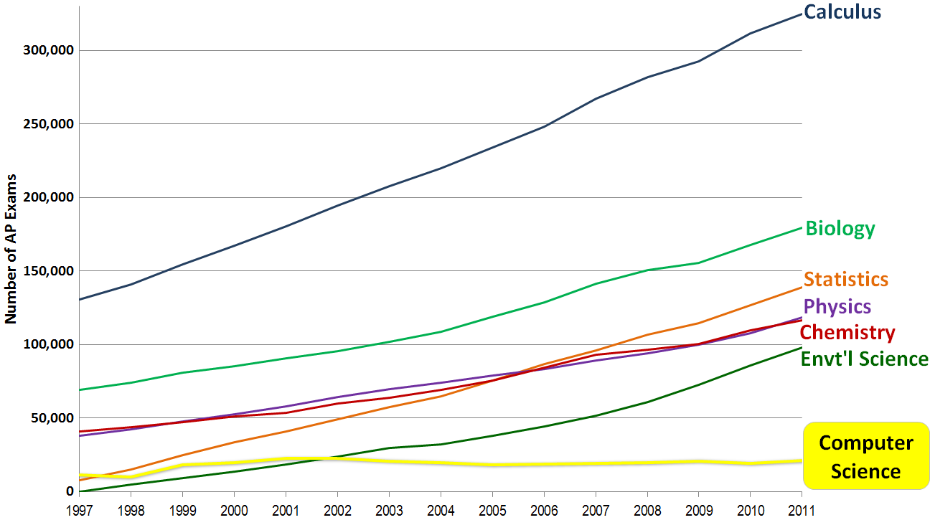
High School Advanced Placement
Exams 1997-2011
Source: College Board, Advanced Placement (AP) Exam Data 2011, available at http://professionals.collegeboard.com/data-reports-research/ap/data. Calculus represents the combined data of Calculus AB and BC. Physics represents the combined data of Physics B, C:Electricity and Magnetism, and C:Mechanics. Computer Science represents combined data of Computer Science A and B.
Notes:
Messaging: Need for increased education
Physics B, C: Electricity and Magnetism, and C: Mechanics, combined
Calculus AB and BC combined
Computer Science A and B combined. B is no longer offered.
Total Exams 2011: 3.4 million
Total Exams 1997: 0.9 million

Slide 21
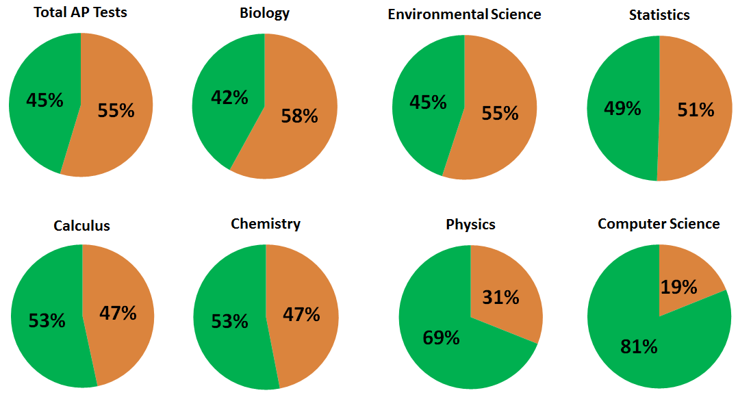
High School Advanced Placement
Exams 2011
Male
Female
Computer Science
Source: College Board, Advanced Placement (AP) Exam Data 2011, available at http://professionals.collegeboard.com/data-reports-research/ap/data. Calculus represents the combined data of Calculus AB and BC. Physics represents the combined data of Physics B, C:Electricity and Magnetism, and C:Mechanics. Computer Science represents combined data of Computer Science A and B.
Notes:
Messaging: Need for increased education
Total computer science exams
21,139
(2% of the sciences shown, 1% of all AP exams)
Females
4000 exams in CS
(19% of all computer AP exams: average score: 2.86)
Males
17139 exams in CS
(81% of all computer AP exams; average score: 3.15)

Slide 22
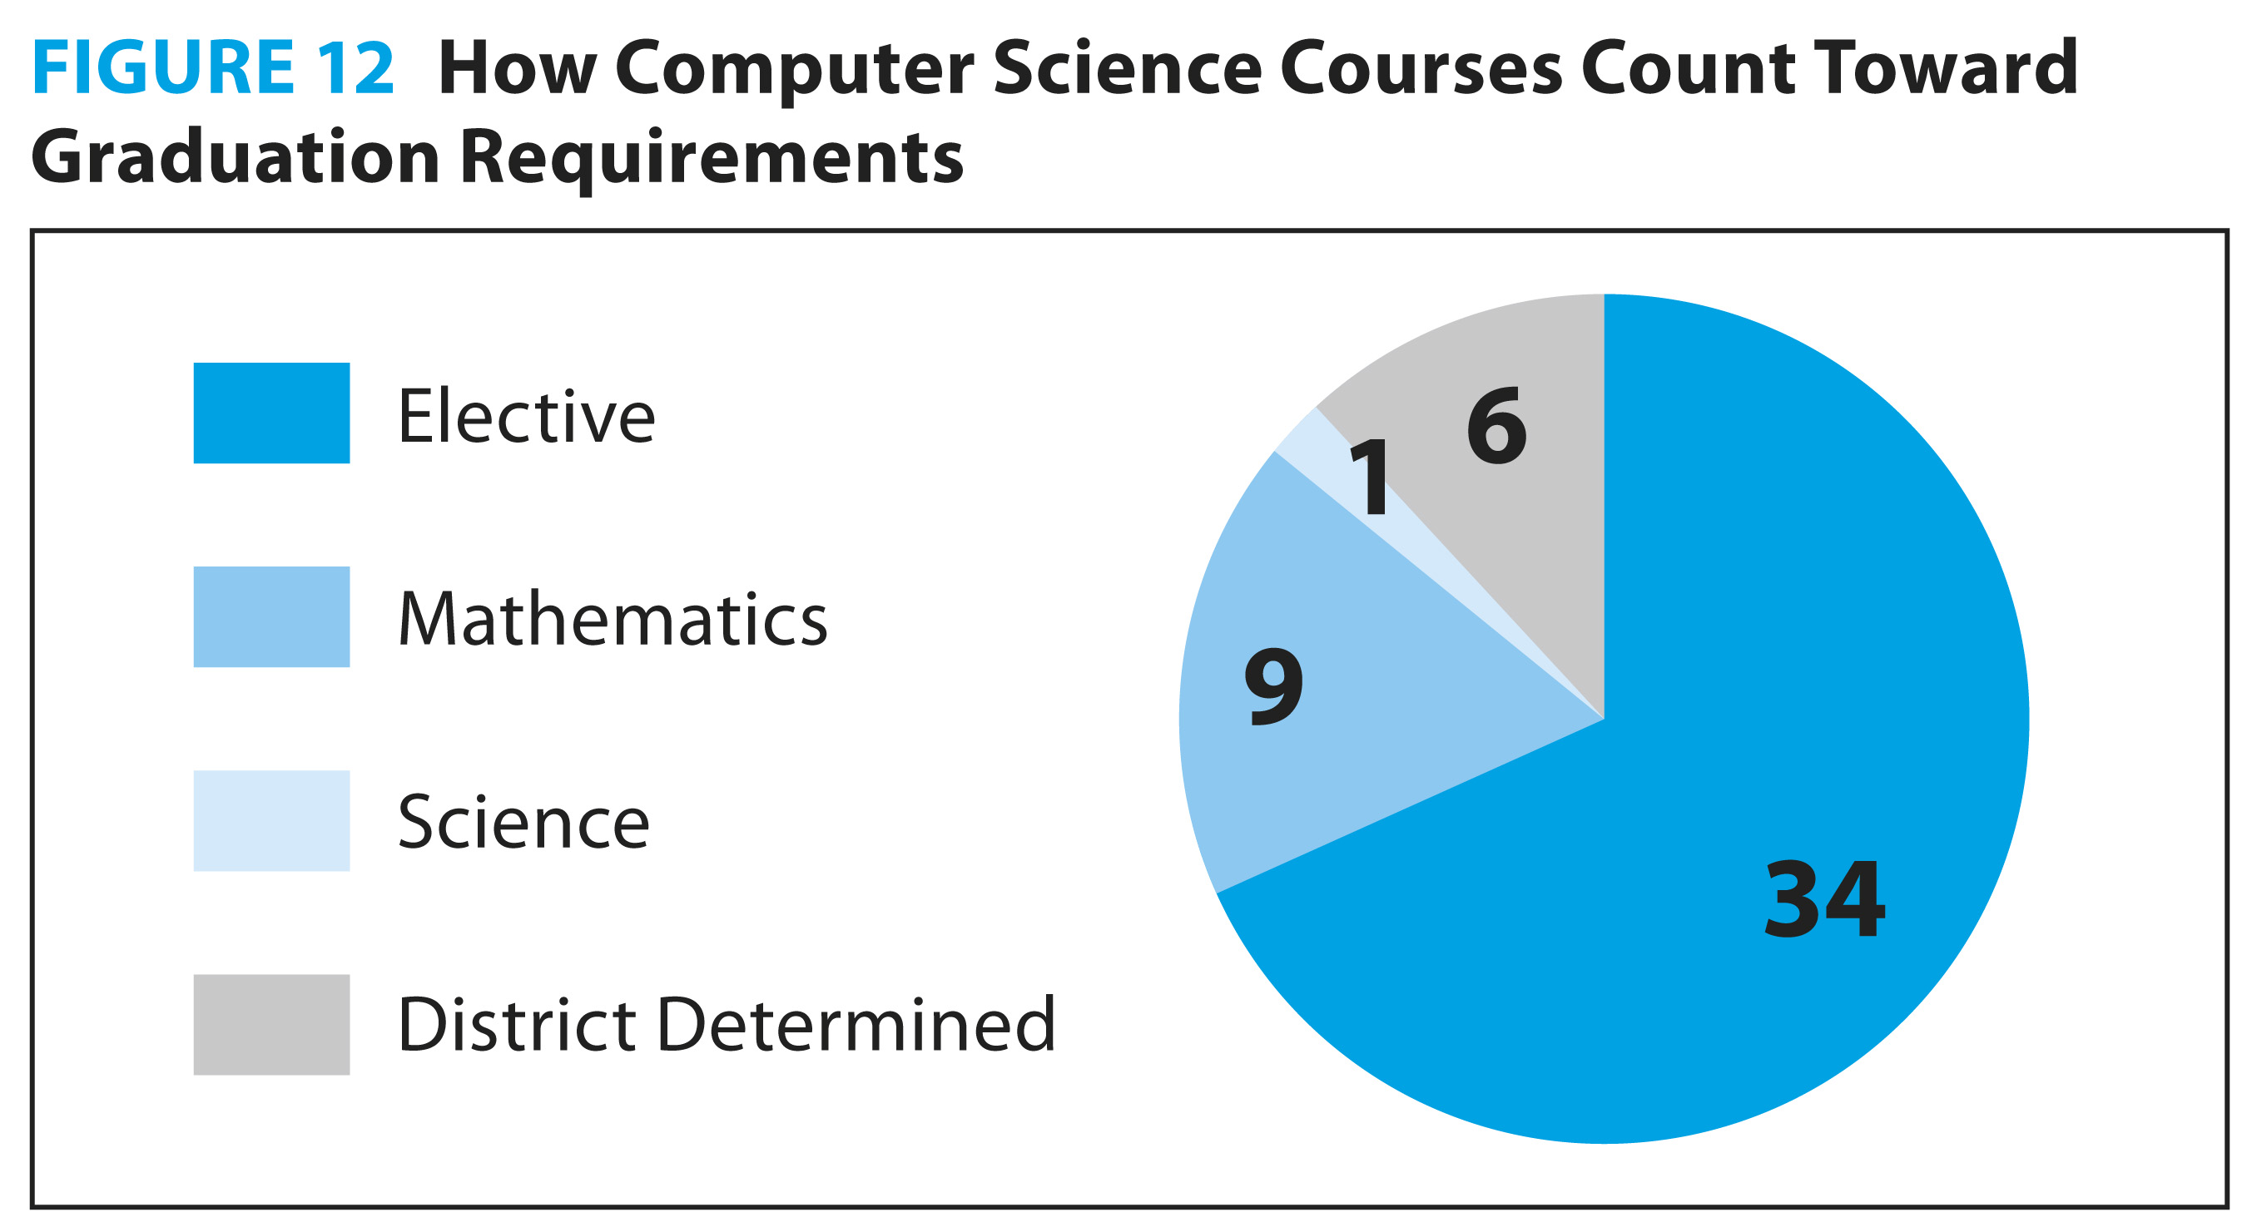
How Computer Science “Counts” In K-12
8
35
Source: Association for Computing Machinery & Computer Science Teachers Association, Running on Empty: The Failure to Teach K-12 Computer Science in the Digital Age (2010), at page 45, available at http://www.acm.org/Runningonempty.
Notes:
Messaging: Need for increased education
ACM and CSTA have 55 model standards that break across three levels – Level 1, K-8, Level II, 9-10, Level III, 10-11.This shows the adoption rates within the states of the level II and level III ACM and CSTA’s CS education standards. So if a state had a matching standard it counted as “hit” and count toward the total percent adopted. This chart shows adoption rates of secondary education standards, or what we call our Level II, for 9-10 grade, and Level III, for 10-11 grades. So Kansas on this chart had one state standard out of the 20 total Level II/III standard. The national snapshot is bleak – over 2/3 of the entire country has adopted less than 50% of level II/III standards. Further, 14 states do not have one level II or level III standard.
NOTE – if it comes up why we didn’t look at the level IV standards, it is because we don’t have level IV standards, we reference courses (such as AP CS) instead of standards for that level. From the report: “Finally, the Level IV (recommended for grade 11 or 12) offering is an elective that provides depth of study in one particular area of computer science. This may take a number of forms including, for example, an AP computer science course, a projects-based course in multimedia design, or a vendor-supplied course that leads to professional certification. (An analysis of gaps in Level IV
standards was not included in this study because there are no standards listed, instead potential course topics are offered.)”

Slide 23
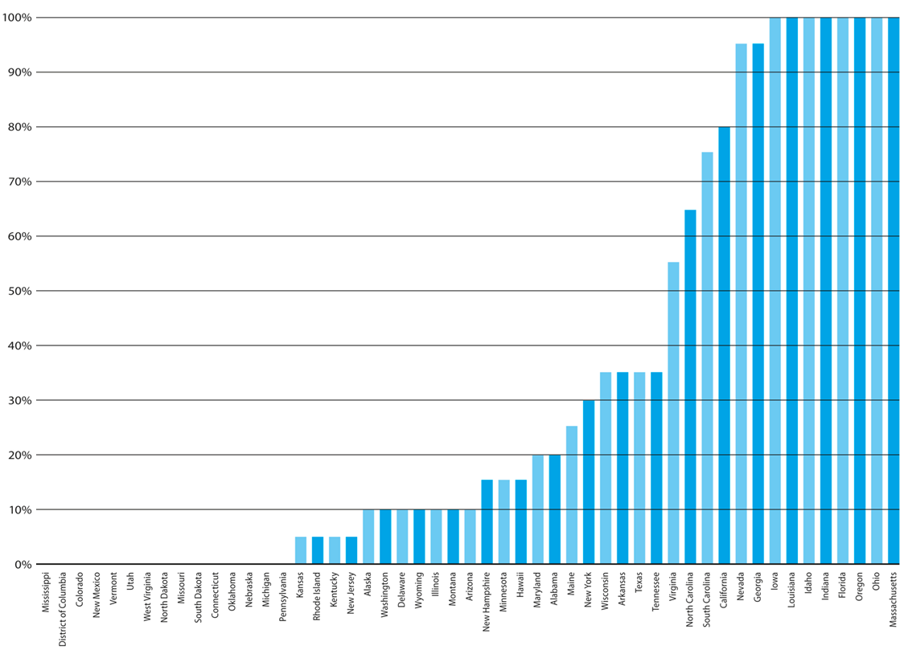
Findings: Standards
Percentage of Secondary School Computer Science Standards
Level II and Level III Adopted by State
Source: Association for Computing Machinery & Computer Science Teachers Association, Running on Empty: The Failure to Teach K-12 Computer Science in the Digital Age (2010), at page 8, available at http://www.acm.org/Runningonempty.
Notes:
Messaging: Need for increased education
ACM and CSTA have 55 model standards that break across three levels – Level 1, K-8, Level II, 9-10, Level III, 10-11.This shows the adoption rates within the states of the level II and level III ACM and CSTA’s CS education standards. So if a state had a matching standard it counted as “hit” and count toward the total percent adopted. This chart shows adoption rates of secondary education standards, or what we call our Level II, for 9-10 grade, and Level III, for 10-11 grades. So Kansas on this chart had one state standard out of the 20 total Level II/III standard. The national snapshot is bleak – over 2/3 of the entire country has adopted less than 50% of level II/III standards. Further, 14 states do not have one level II or level III standard.
NOTE – if it comes up why we didn’t look at the level IV standards, it is because we don’t have level IV standards, we reference courses (such as AP CS) instead of standards for that level. From the report: “Finally, the Level IV (recommended for grade 11 or 12) offering is an elective that provides depth of study in one particular area of computer science. This may take a number of forms including, for example, an AP computer science course, a projects-based course in multimedia design, or a vendor-supplied course that leads to professional certification. (An analysis of gaps in Level IV
standards was not included in this study because there are no standards listed, instead potential course topics are offered.)”

Slide 24
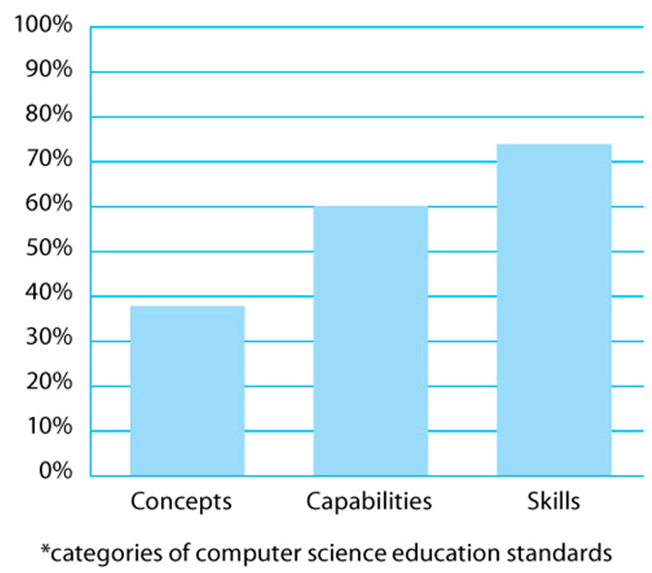
Findings: Standards
National Snapshot: Adoption of Computer Science Standards*
Source: Association for Computing Machinery & Computer Science Teachers Association, Running on Empty: The Failure to Teach K-12 Computer Science in the Digital Age (2010), at page 7, available at http://www.acm.org/Runningonempty.
Notes:
Messaging: Need for increased education
There is another way to look at the state adoption rate of ACM and CSTA’s model standards. You can sort the 55 standards into three computing education “buckets” or categories that were defined by the National Academies – skills, capabilities and concepts. The above figure shows a national picture of the adoption rate of all of the ACM/CSTA standards (so level I,II,III) broken across these three categories. This is really just another way of cutting the same data.
The key point is that states have largely adopted skill-based standards (i.e., using a computer in other learning activities), instead of deeper conceptual knowledge (i.e., develop an understanding of an algorithm) students need to succeed in the 21st Century.

Slide 25
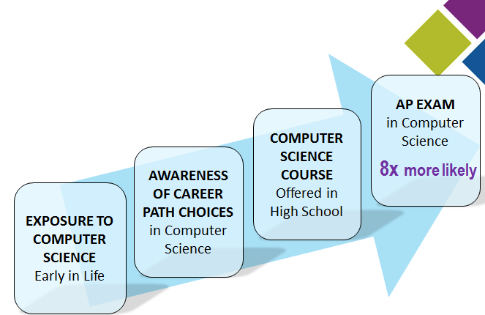
Why K-12 Computer Science Education?
Factors in Choice of College Major in Computer Science
Source: College Board, Is AP Exam Participation and Performance Related to Choice of College Major? (Research Report 2011-06, 2011), available at http://professionals.collegeboard.com/profdownload/pdf/RR2011-6.pdf. Google, Survey Results of U.S. Employees (2010) (unpublished).
Notes:
Still in progress
Messaging: Need for increased education
AP Survey Results
17.9 % of AP computer science students majored in computer and information sciences, compared to 2.3 % of the total sample. The students’ majors at the beginning of their 3rd year, as reported by institutions.
Google Survey Results
In the summer of 2010, Google surveyed a sample of its US employees about exposure to CS prior to college.
Nearly all CS majors (98%) reported being exposed to CS prior to college, compared to less than half of non-CS majors (45%). The nature of the exposure varied from reading about CS, after-school programs or camps, to middle or high school CS classes.
Those who went on to major in CS were more likely than non-majors to have had a CS class offered in their high school.
CS majors were more likely to have known that CS was a possible career path when they were in high school.
Based on these findings, we believe that exposing students to CS before college is crucial to growing interest and enrollment in CS majors and careers.

Slide 26
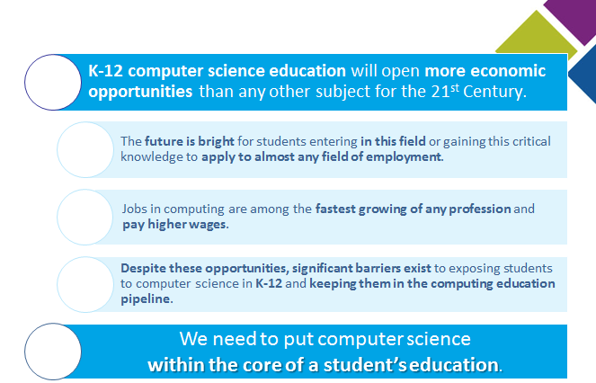
Conclusion
Notes:
Conclusion

